Slide 1
WormMine and SimpleMine
Chris Grove
WormBase Workshop
21st International C. elegans Conference
UCLA, June 2017

Slide 2
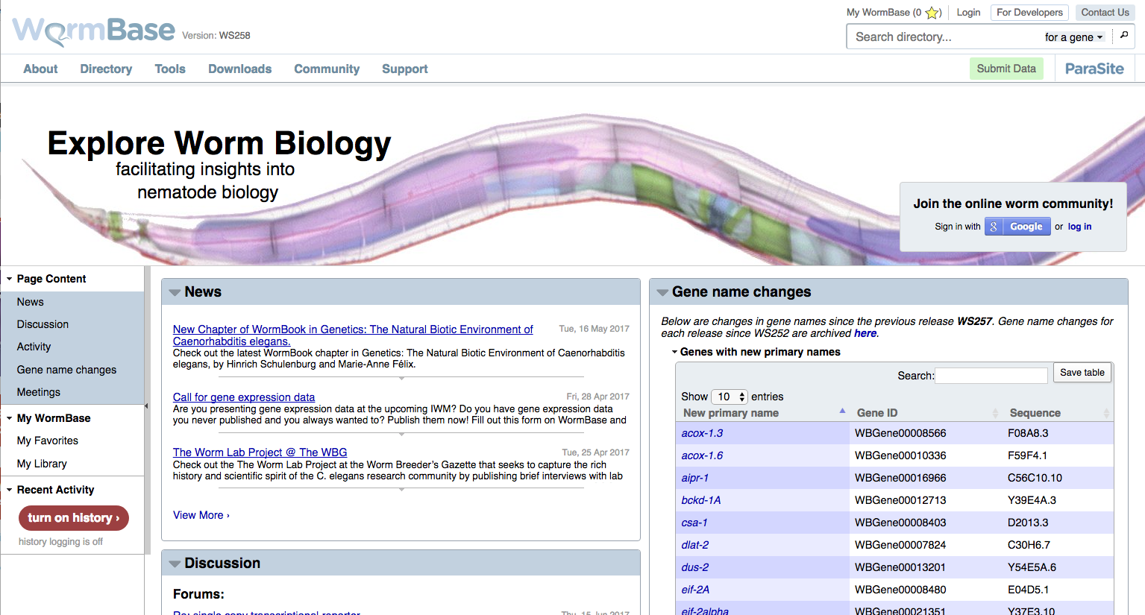

Slide 4
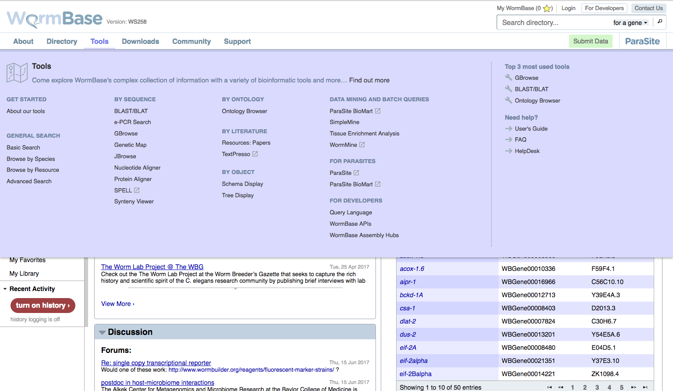

Slide 6
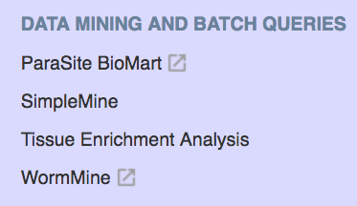

Slide 8
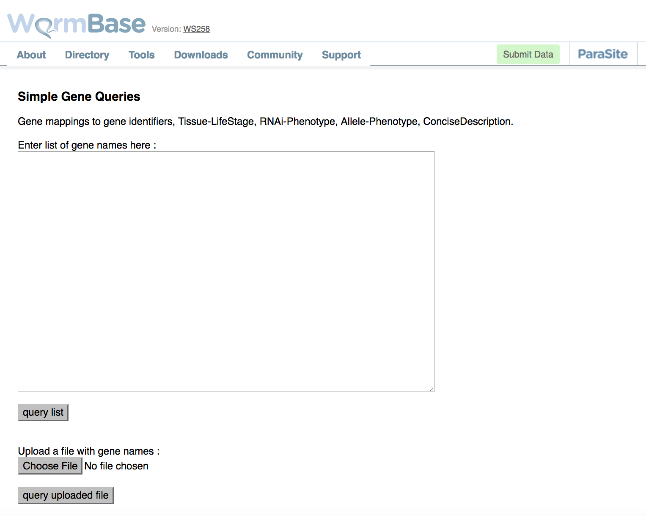
SimpleMine
unc-13
WBGene00001949
W02C12.3
Notes:
Default data returned: Gene ID and description

Slide 9
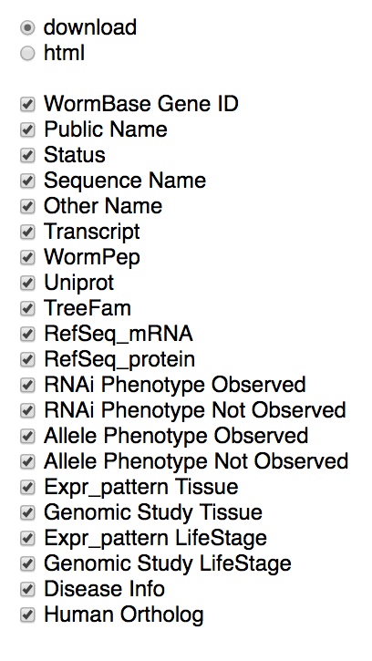
SimpleMine
unc-13
WBGene00001949
W02C12.3
Notes:
Default data returned: Gene ID and description

Slide 10
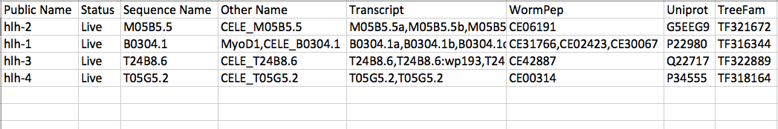
SimpleMine results (download tab-delimited file)

Slide 11
SimpleMine results (download tab-delimited file)
WARNING: The following genes will often be automatically converted to dates in spreadsheet programs like Excel:
feb-1, mar-1, apr-1, jun-1, sep-1, oct-1, oct-2, dec-1, dec-2, dec-7, dec-9, dec-10, dec-11, dec-12
Make sure you import as “Text” and not as “General”

Slide 12
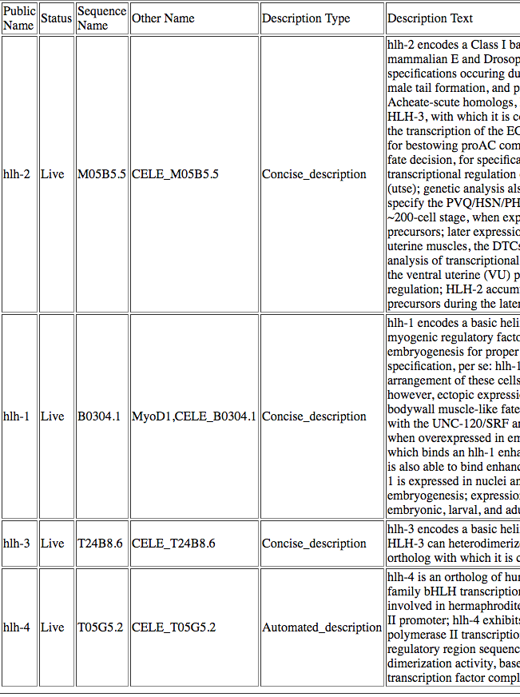
SimpleMine results
(html)

Slide 15
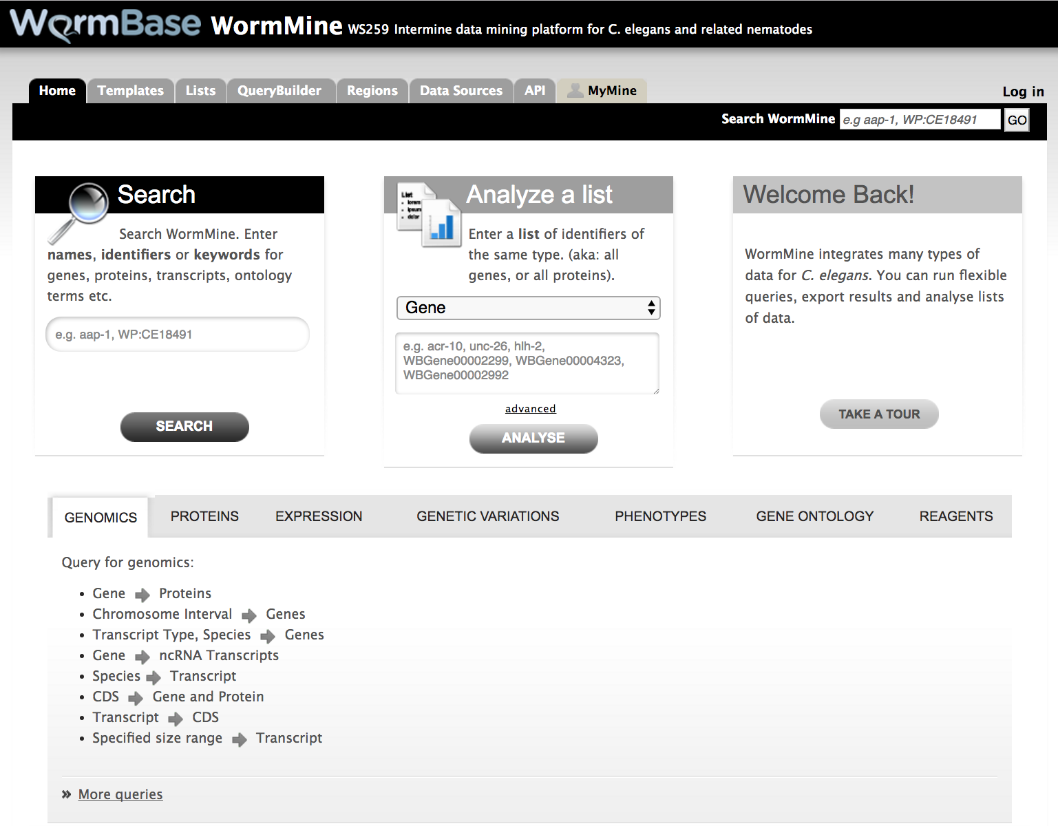

Slide 17
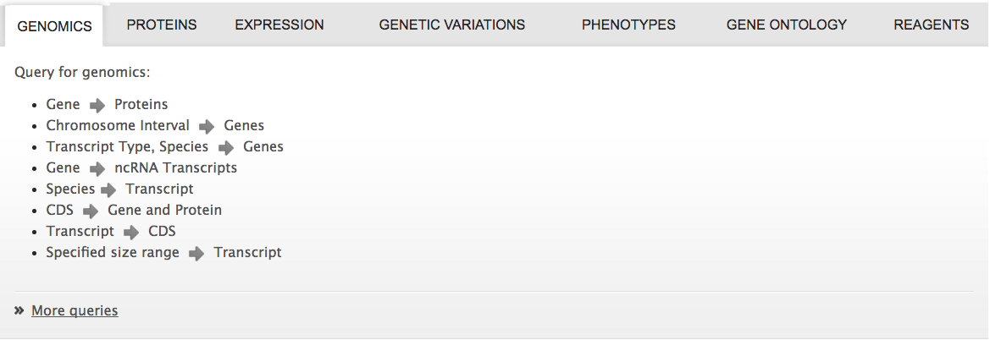

Slide 19
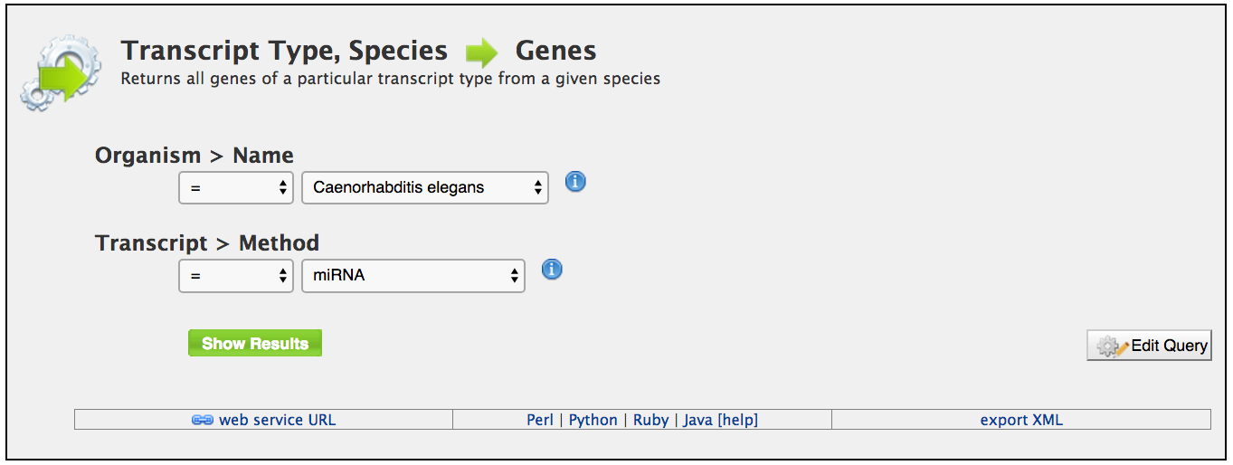

Slide 20
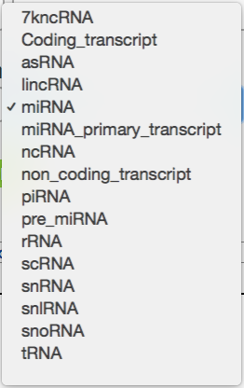

Slide 22
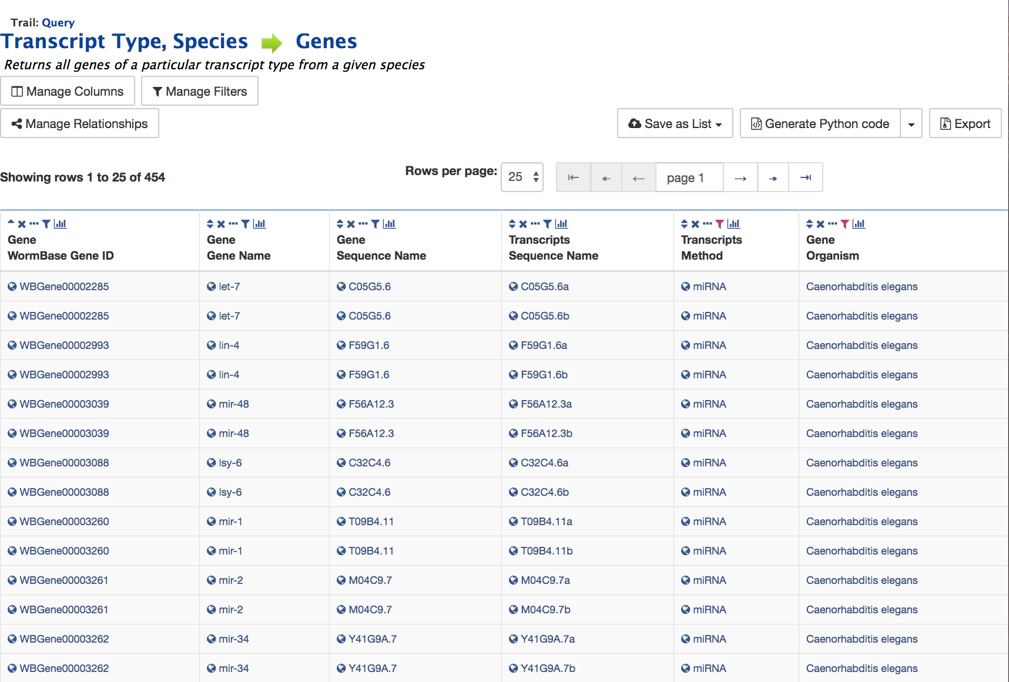

Slide 24
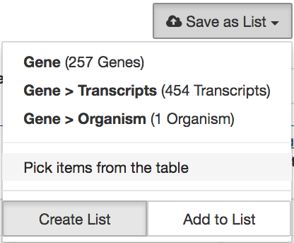

Slide 26
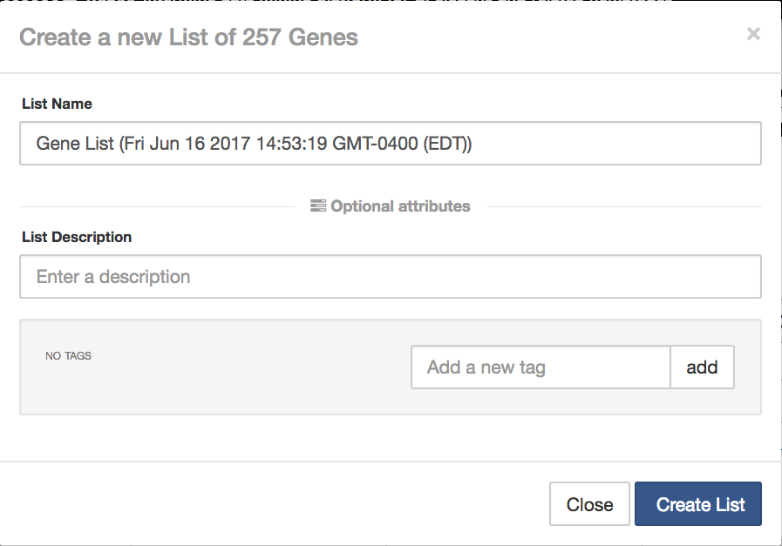

Slide 27
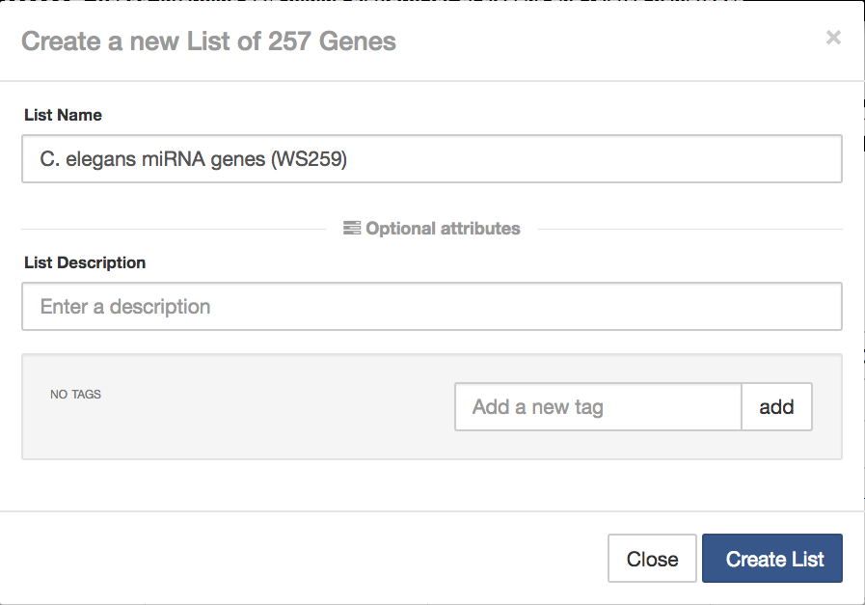

Slide 29
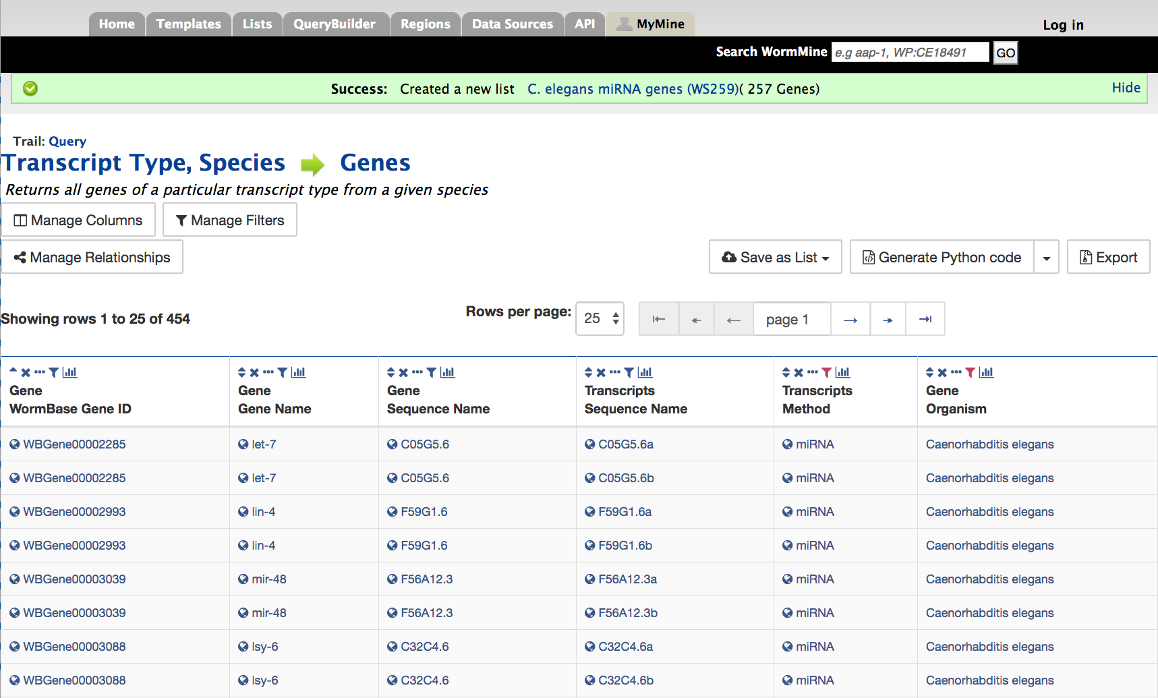

Slide 31
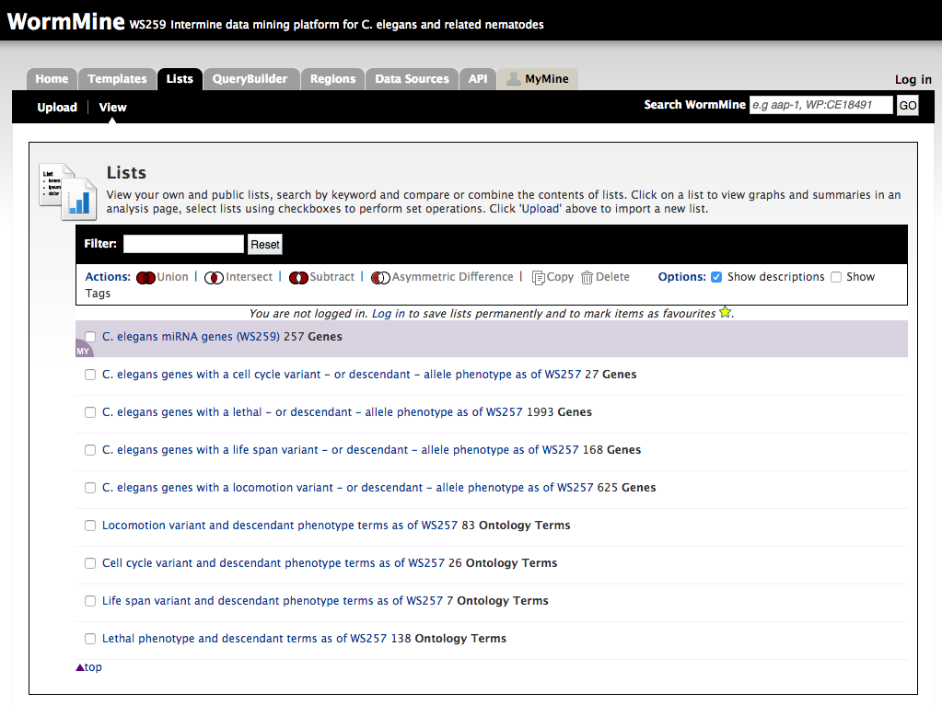

Slide 32
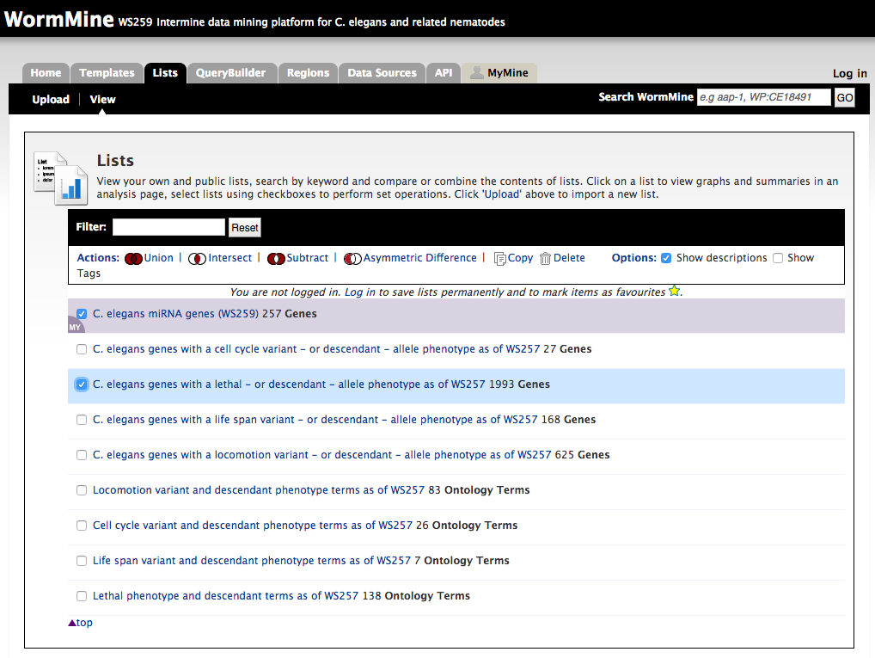

Slide 36
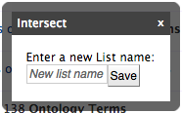

Slide 37
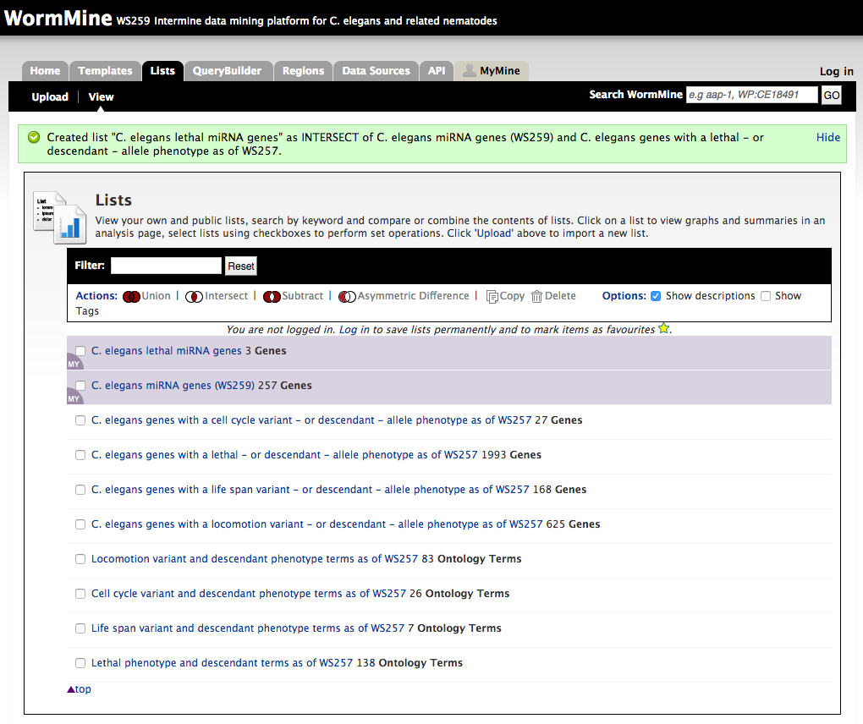

Slide 40
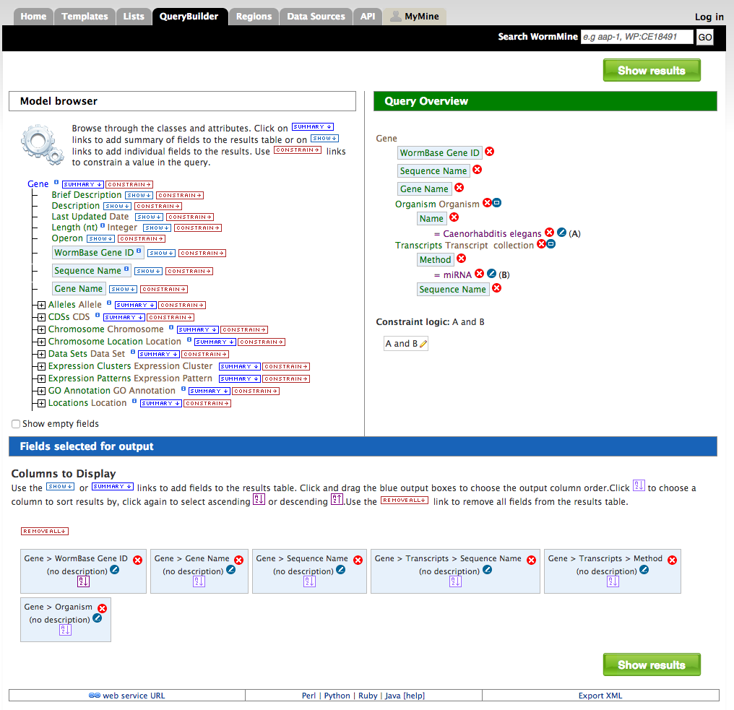

Slide 42
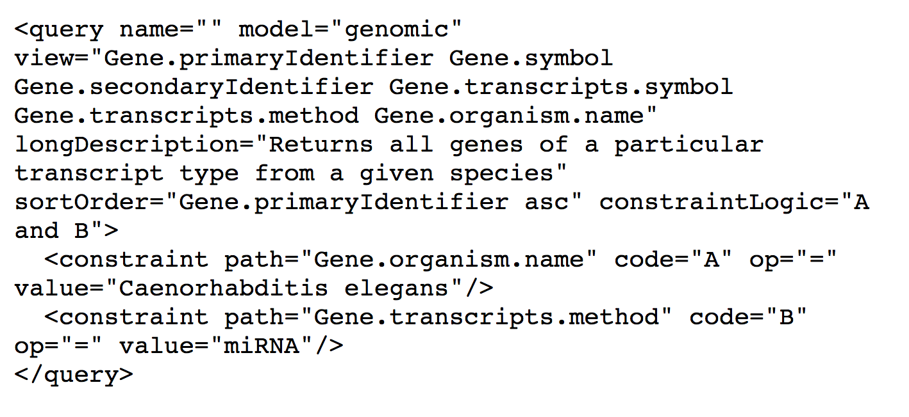

Slide 43
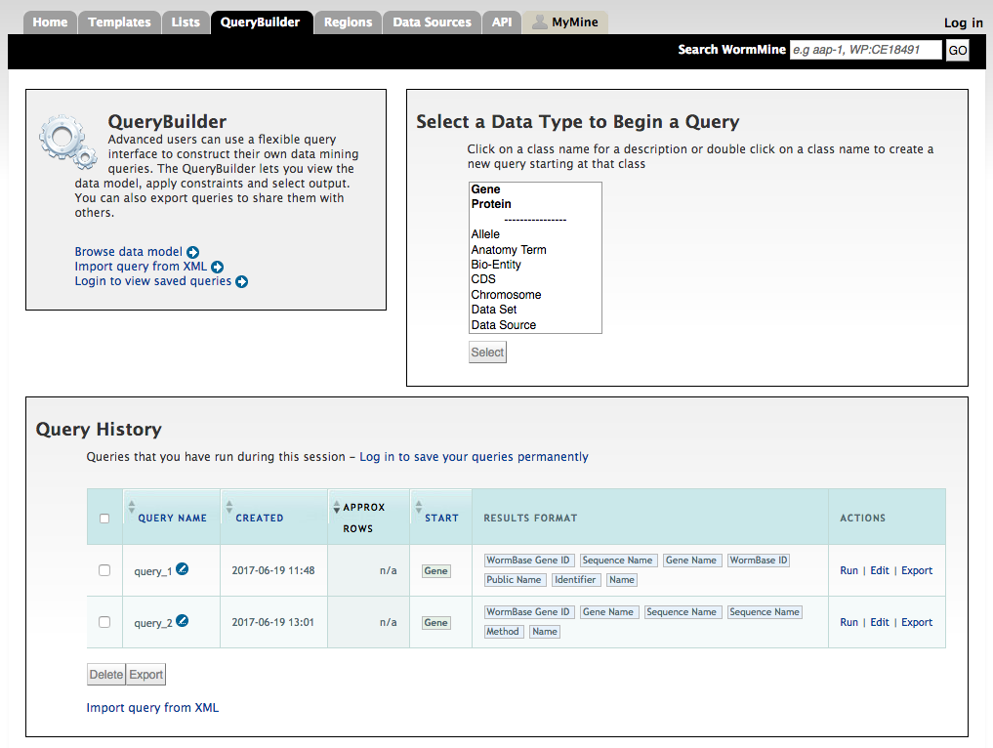

Slide 45
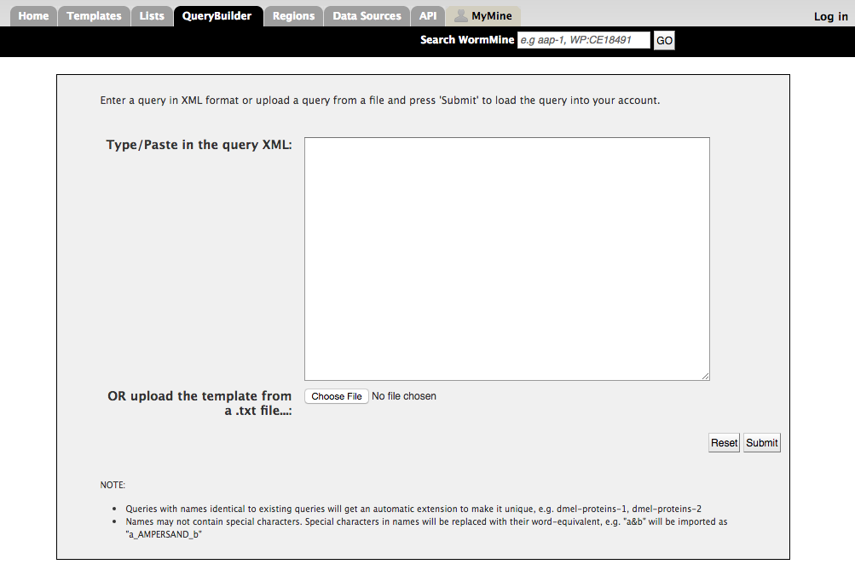

Slide 46
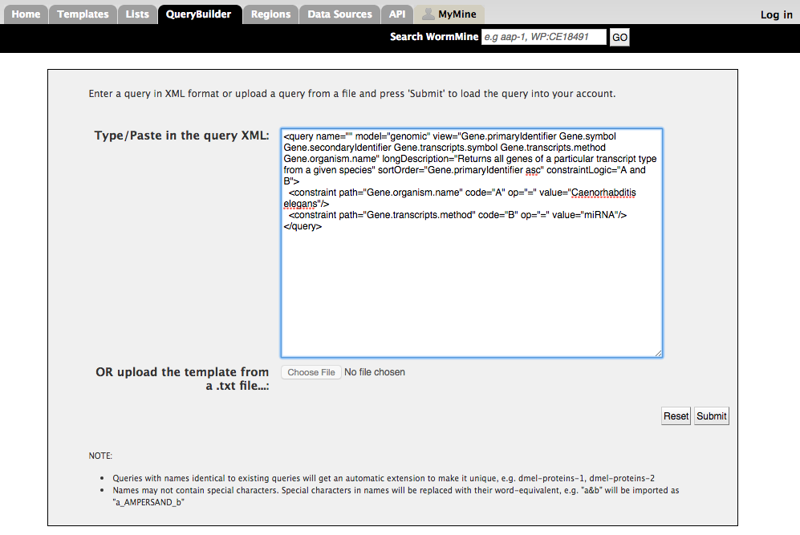

Slide 51
Thanks!!
SimpleMine
Wen Chen
Juancarlos Chan
WormMine
Todd Harris
Paulo Nuin
Email: help@wormbase.org

