Slide 1
Ontology Annotation Browsing Made Easy - SObA
Raymond Lee*, Juancarlos Chan, Chris A. Grove, and Paul W. Sternberg
June 2017
21st International C. elegans Conference
Los Angeles, CA

Slide 2
Extensive Use of Ontologies
Controlled vocabulary in a hierarchy.
Developed @ WormBase
 | Total Terms (% Used) | Annotations / Genes
Gene (GO) | 44,458 (21%) | 318,561 / 79,949
Anatomy (AO) | 6,814 (39%) | 134,163 / 17,609
Phenotype (PO) | 2,423 (88%) | 107,785 / 9,654
Life Stage (LSO) | 731 (75%) | 72,895 / 4,066
Human Disease (DO) | 8,029 (18%) | 3,050 / 1,470
Notes:
At WormBase, we develop ontologies and use these structured controlled vocabularies to annotate genes extensively. Therefore, we want to make sure this information is easily accessible to our users.
Browsing from the perspective of the ontologies,

Slide 3
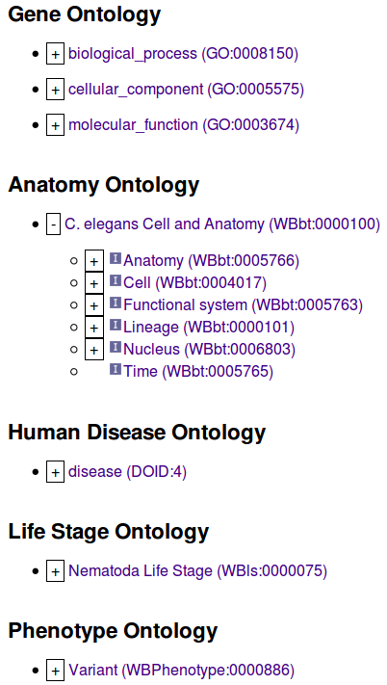
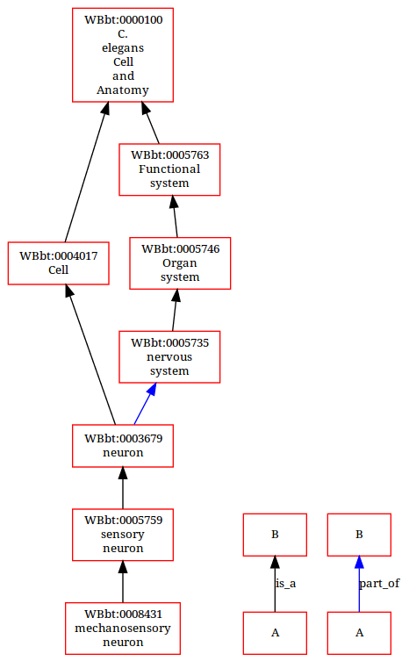
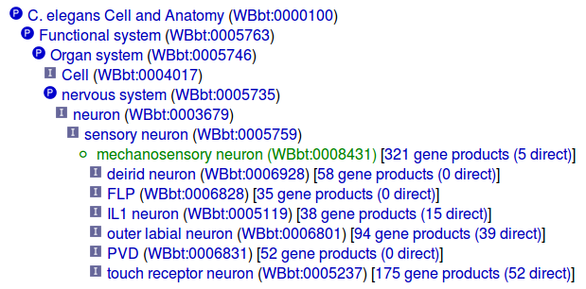
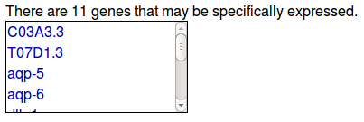
top down
expandable
browser
graph
viewer
WormBase Ontology Browser
WOBr
inference
tree
viewer
canned
query
Notes:
There is a WormBase Ontology Browser suite which offers multiple ways to view the hierarchies and to get at the set of genes annotated with each term.
How about browsing from the Genes’ perspective?

Slide 4
Gene -> Phenotype Annotations
9,600 Genes have reported variation or RNAi phenotypes.
Each Gene has 1-328 annotations.
3,000 Genes have 10 or more annotations.
More annotations to each gene makes it more difficulty to comprehend biological function.
Notes:
Say phenotype annotations:
There are 10 Thousand genes have phenotype annotation
Each gene can have upto 300 annotations (Pop-1 is the winner, followed by daf-16 and daf-2.)
The annotation numbers tend to just keep growing as you publish more and we curate more.
For genes that have more than a few phenotypes, comprehension across them becomes difficult.

Slide 5
User complaints: Lists of mutant phenotypes are difficult to comprehend.

Slide 6
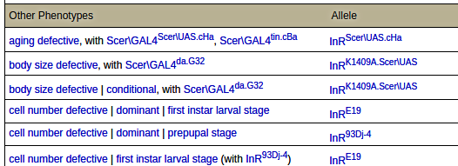
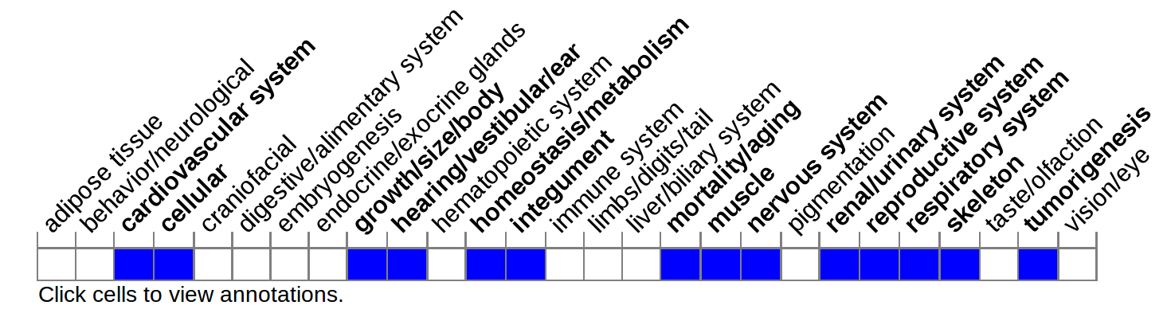
Phenotype Annotation Summary
TABLE fly InR
RIBBON mouse IGF1
Notes:
How can we make long and varied lists more comprehensible? One way is to canned them into a short list of static items.
That is the RIBBON. The benefit of this ribbon approach is that it makes comparisons between genes easier by predefining what phenotypic aspects are important. The potential problem of ribbon approach is just that, it defines what’s important a priori.
We started exploring a graph-based approach.

Slide 7
SObA Graph
Summary of Ontology-based Annotations
Integrated: with ontology hierarchy and logical inference
Complete: broad to detailed, interactive
Simple: graph pruned to essential aspects
Uptodate: dynamic and objective summary view better represents biological meaning
Notes:
The product is the SObA graph.
Because ontologies are intrinsically graphs and graphs are visually intuitive to navigate along hierarchical structures.
The SObA graph fully supports logical inference, each and every annotation is there in the graph but we do prune nonessential parts of the ontology hierarchy to make it less complex. And importantly, the whole graph is redrawn dynamically based on updated data, most of it is not static. We believe that better represent the biological meaning of annotations.

Slide 8
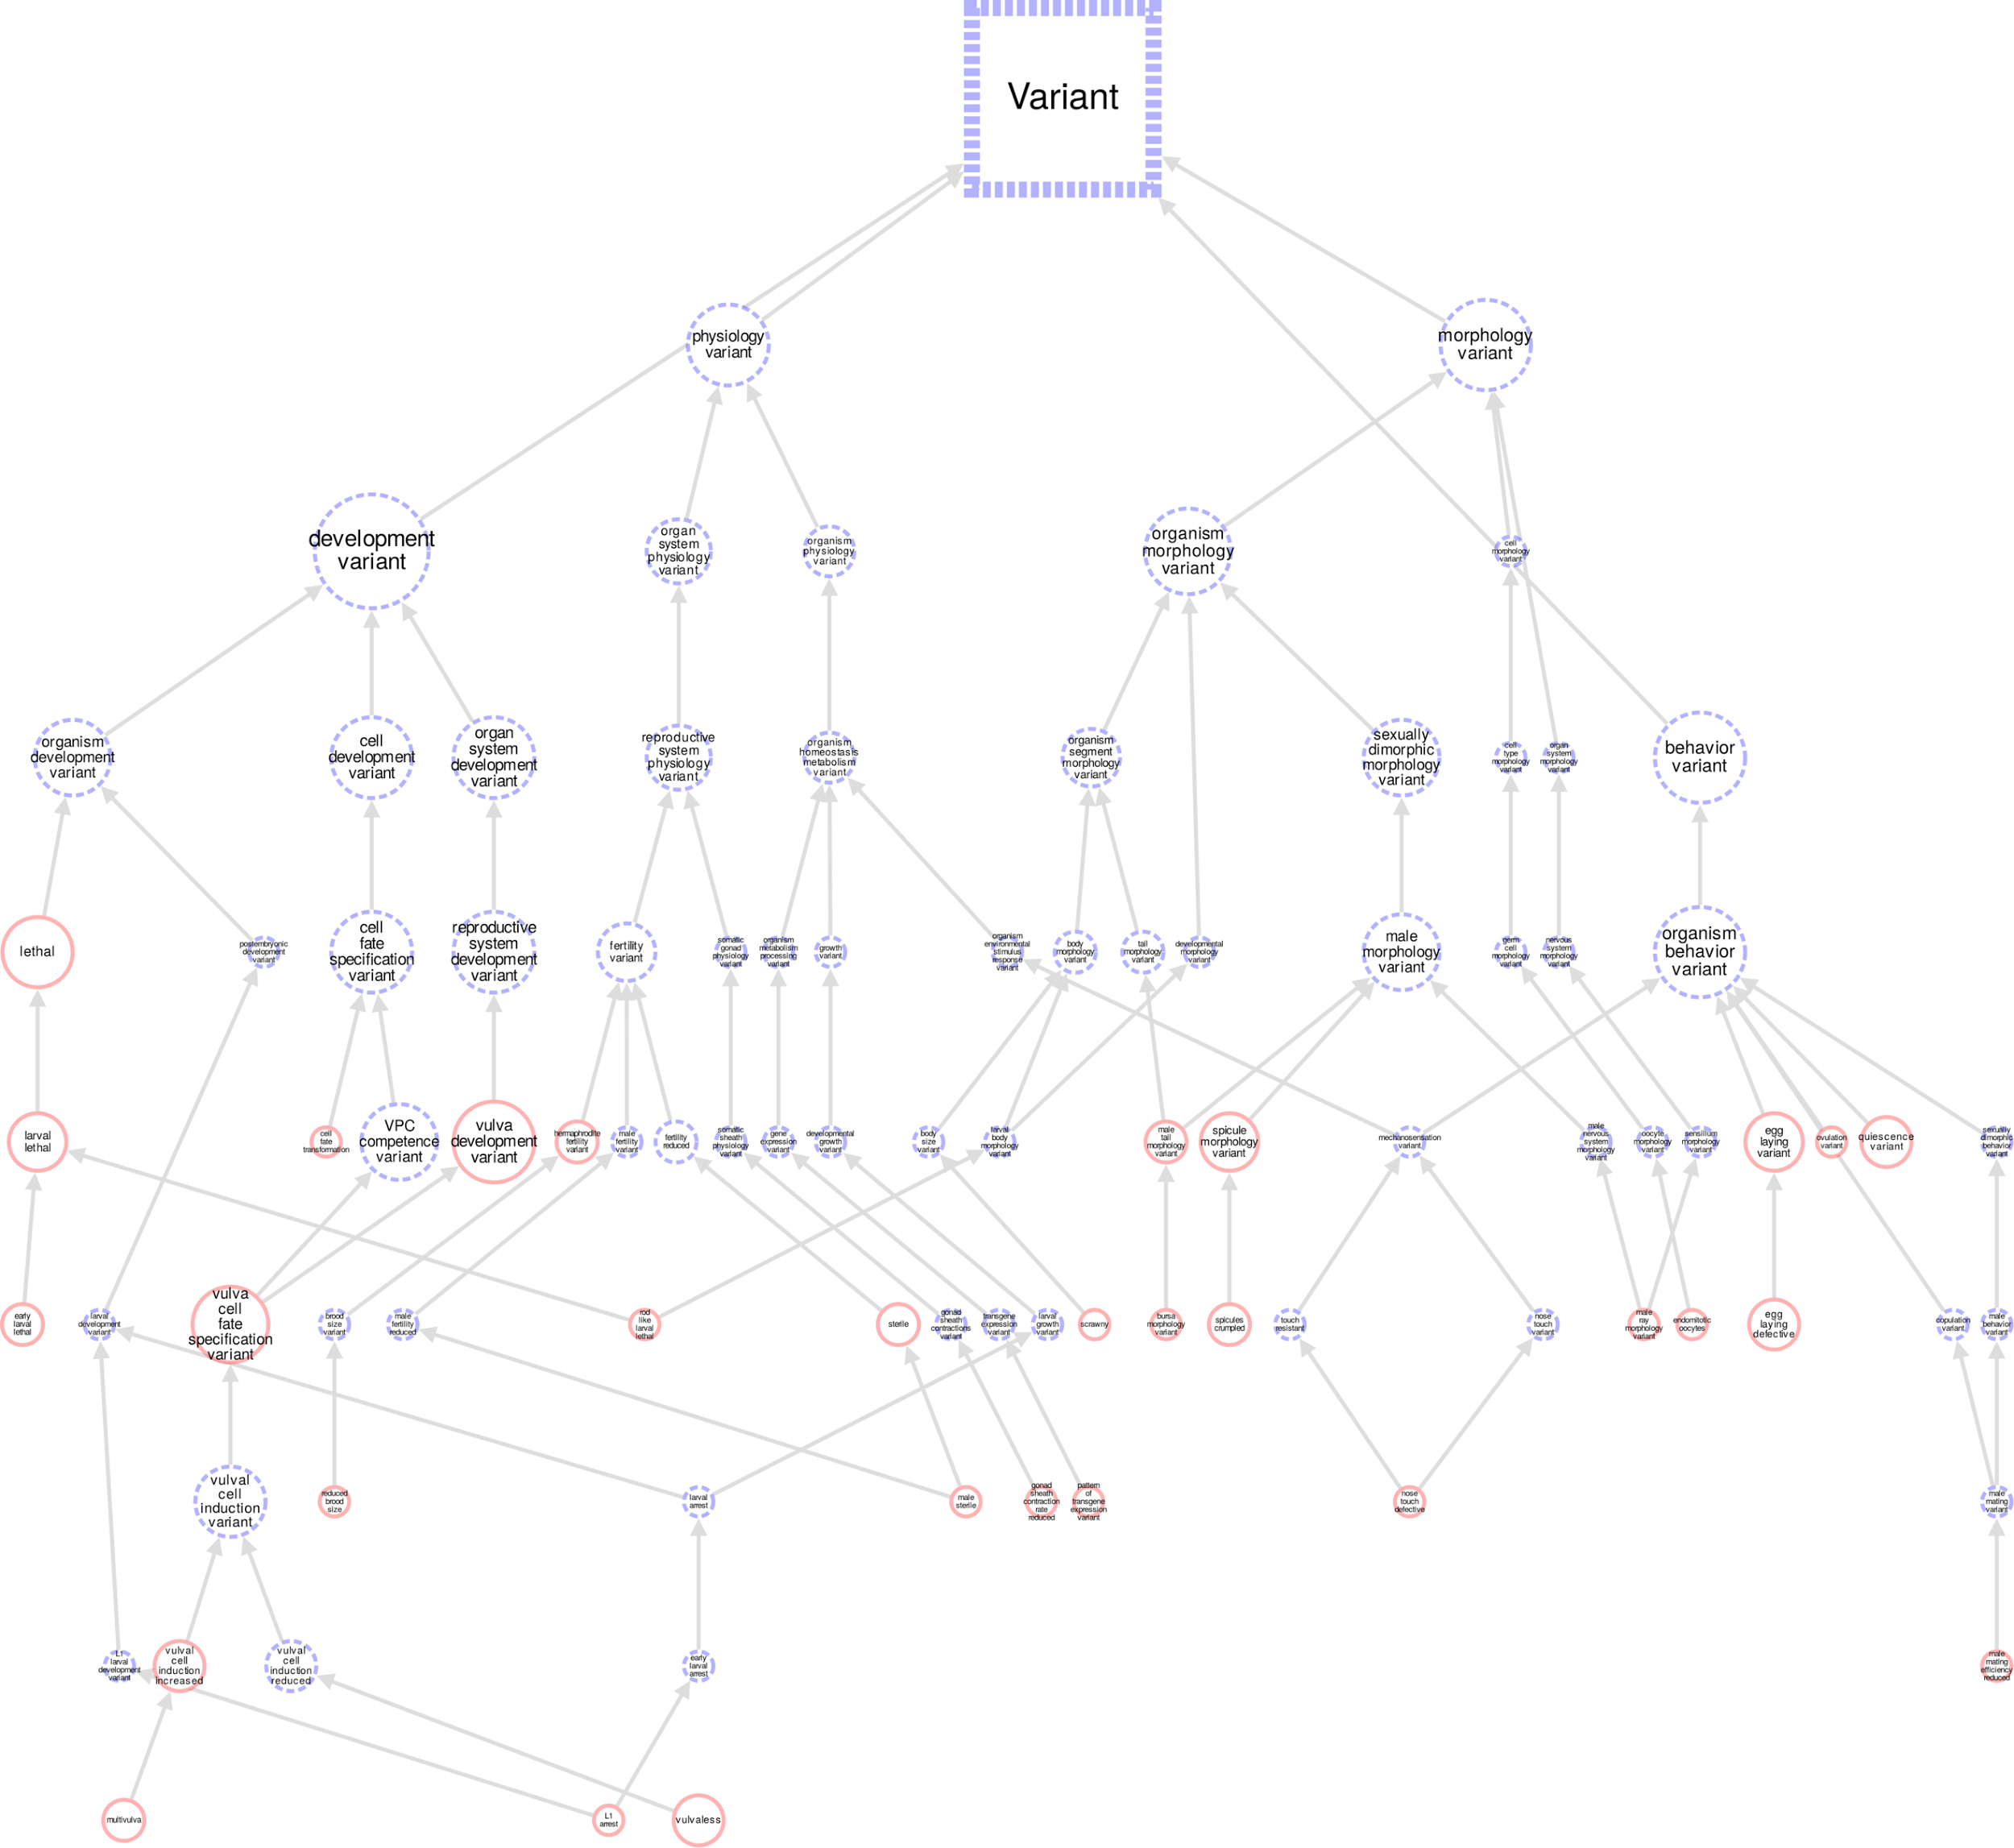
Untrimmed let-23 phenotype graph (92 nodes / 102 edges)
Notes:
Here I use let-23 as an example to show the pruning process.
Let-23 is annotated with 30 phenotype terms. Adding inferred ones, there are 92 annotating terms and the ontology specifies 102 edges among the terms.

Slide 9
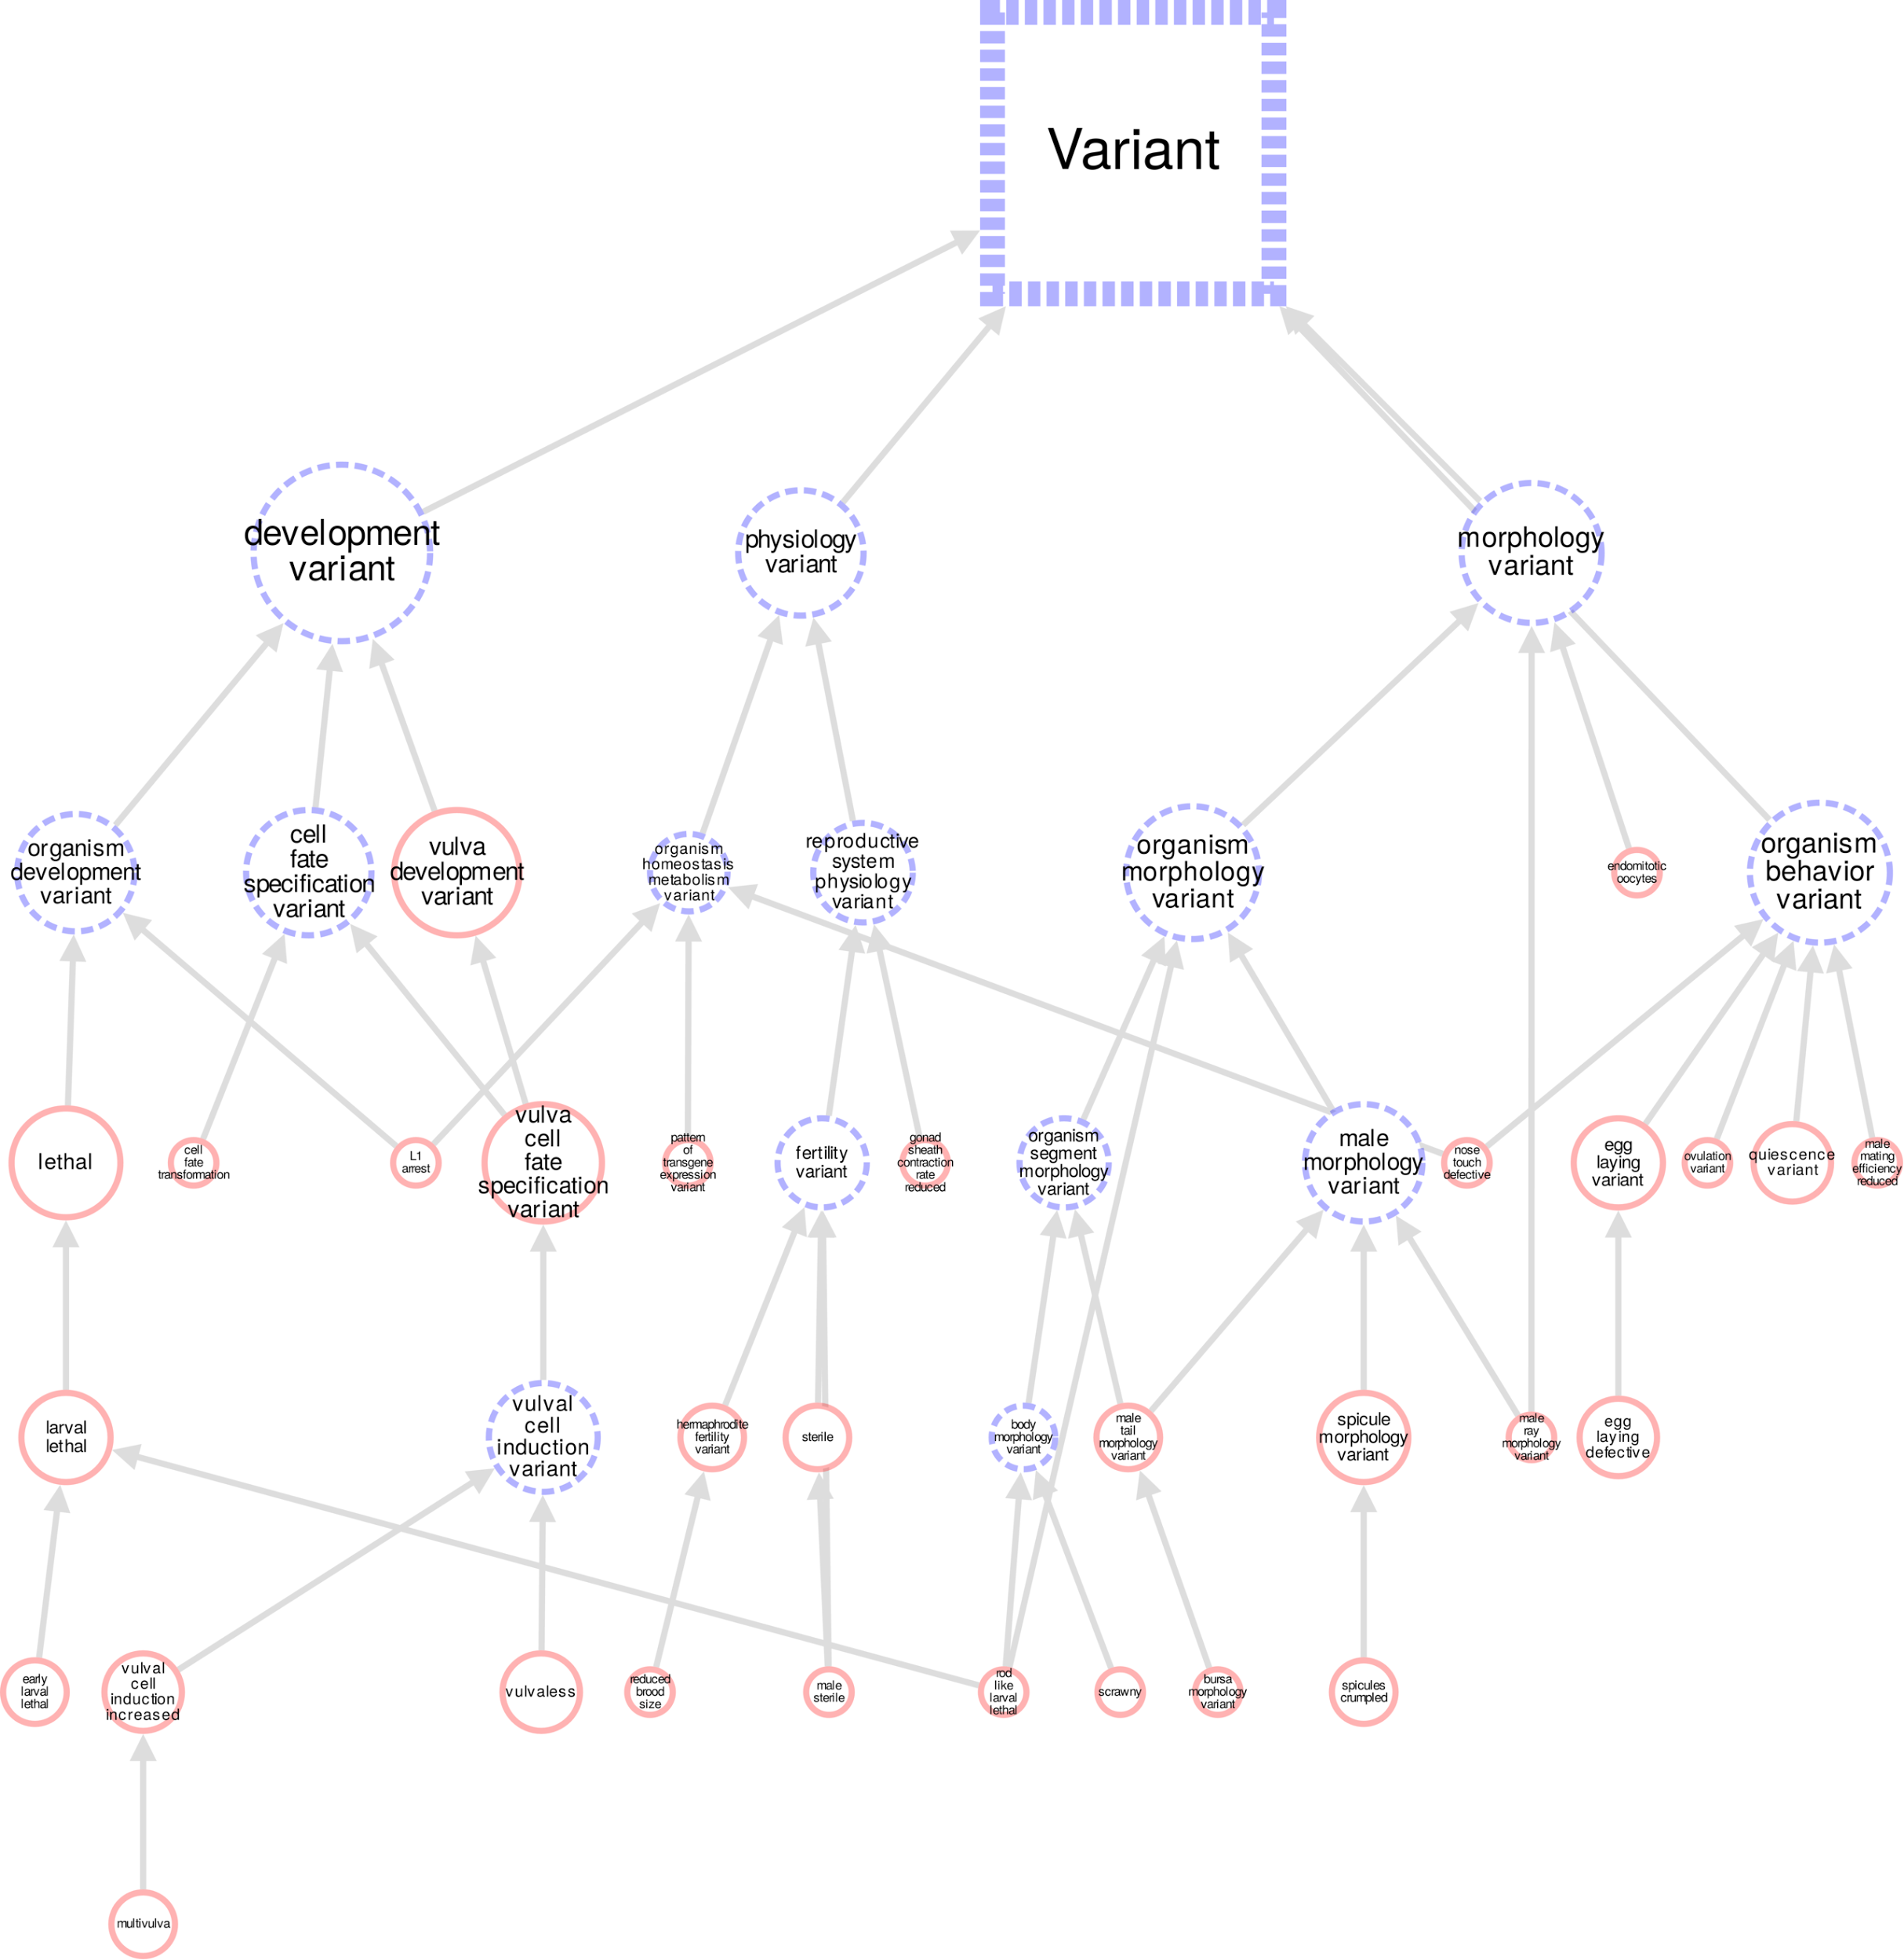
LCA-filtered let-23 phenotype graph (45 nodes / 52 edges)
Notes:
An LCA, lowest common ancestor phenotype is an inferred, broader phenotype that multiple annotating phenotypes share. It represents the union or summary, if you will, of the phenotypes that specialize or partiion from it. For example, “Vulval Cell Induction Variant” is the LCA of “Vulvaless” and “Vulval Cell Induction Increase”.
We think non-LCAs provide less useful information thus they are filtered out.

Slide 10
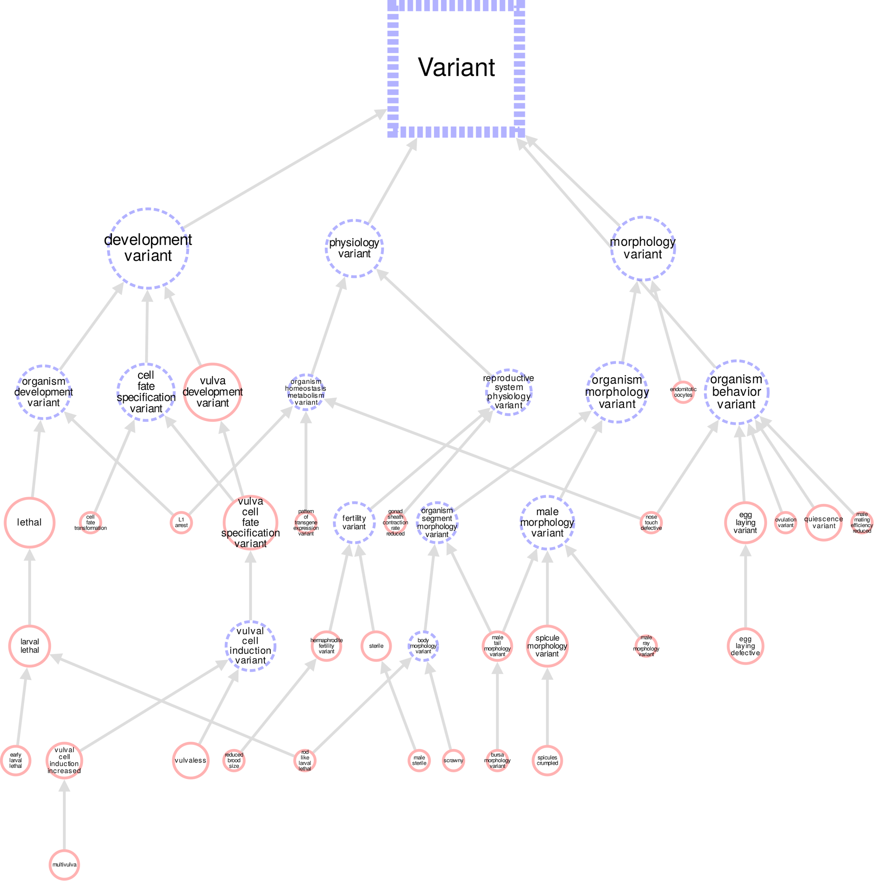
LCA+Longest path-filtered let-23 phenotype graph (45 nodes / 49 edges)
Notes:
We also hide redundant connections to simplify the graph.

Slide 11
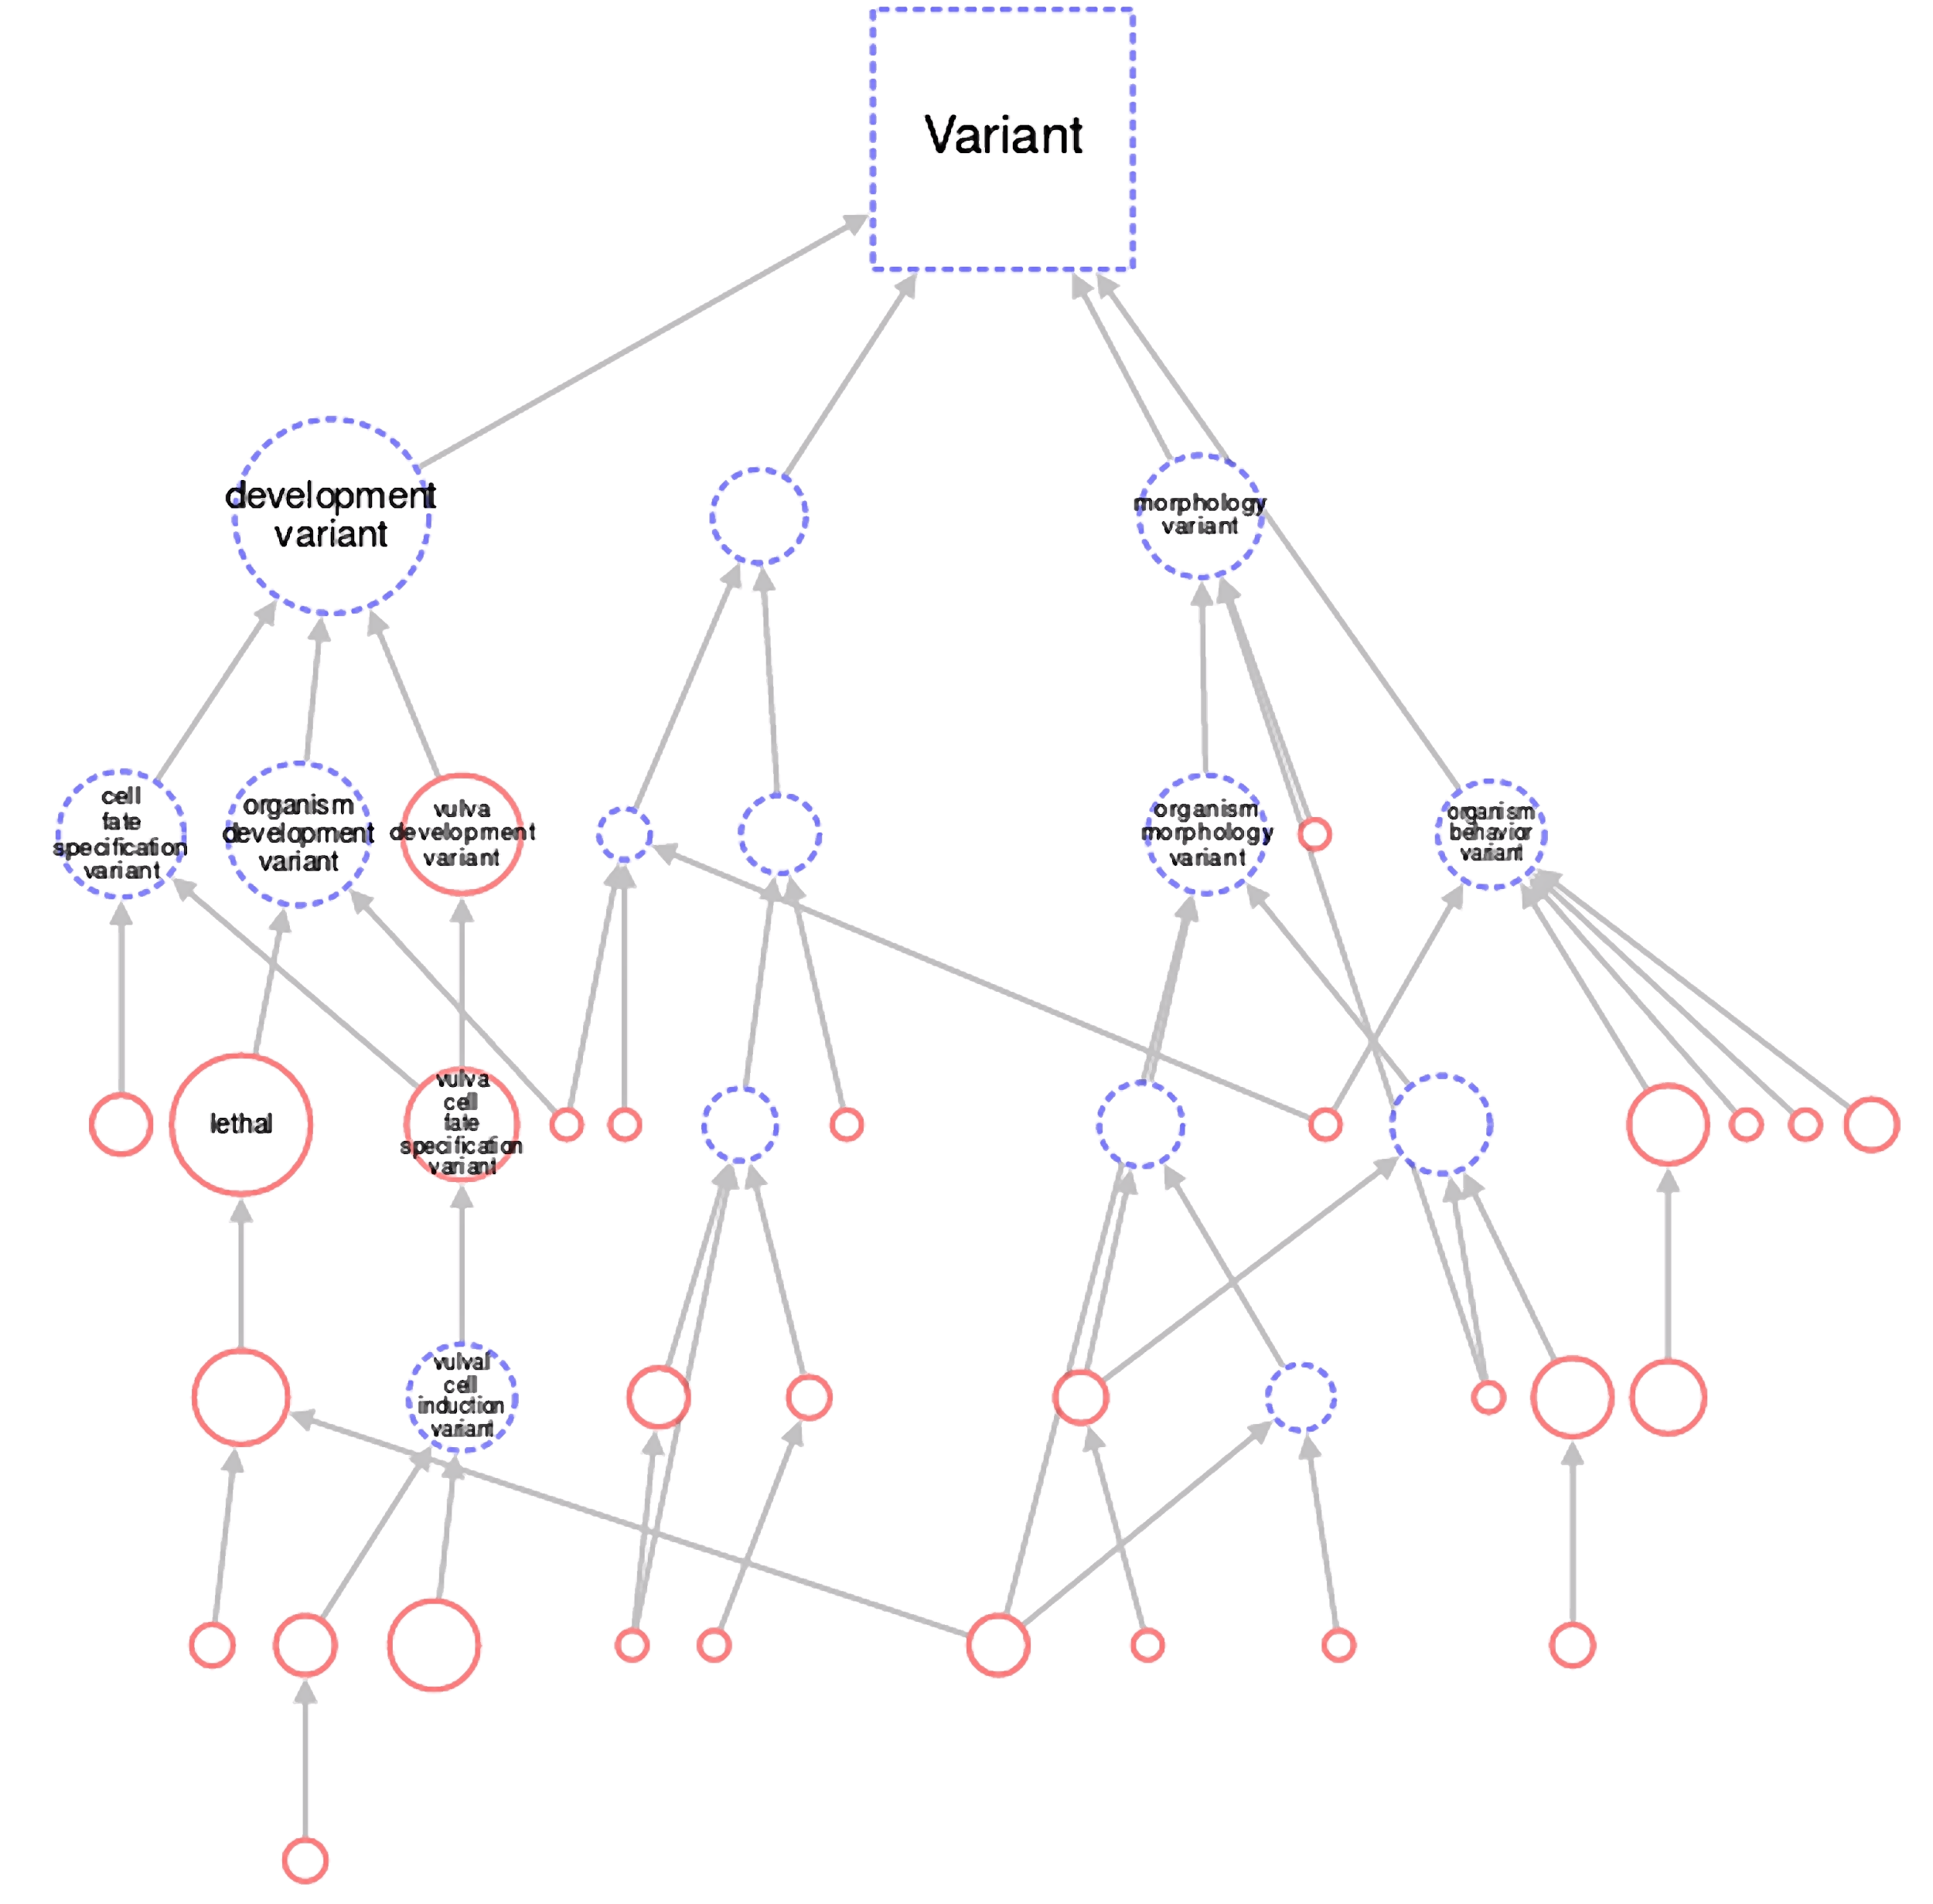
let-23 Phenotype Graph
Live demo

Slide 12
Phenotype Graph Live Demo
Direct vs. Inferred Annotation Nodes
Node Size is Proportional to Annotation Count (on-off)
Interactive graph
Exportable fully labelled graph (staging site)

Slide 13
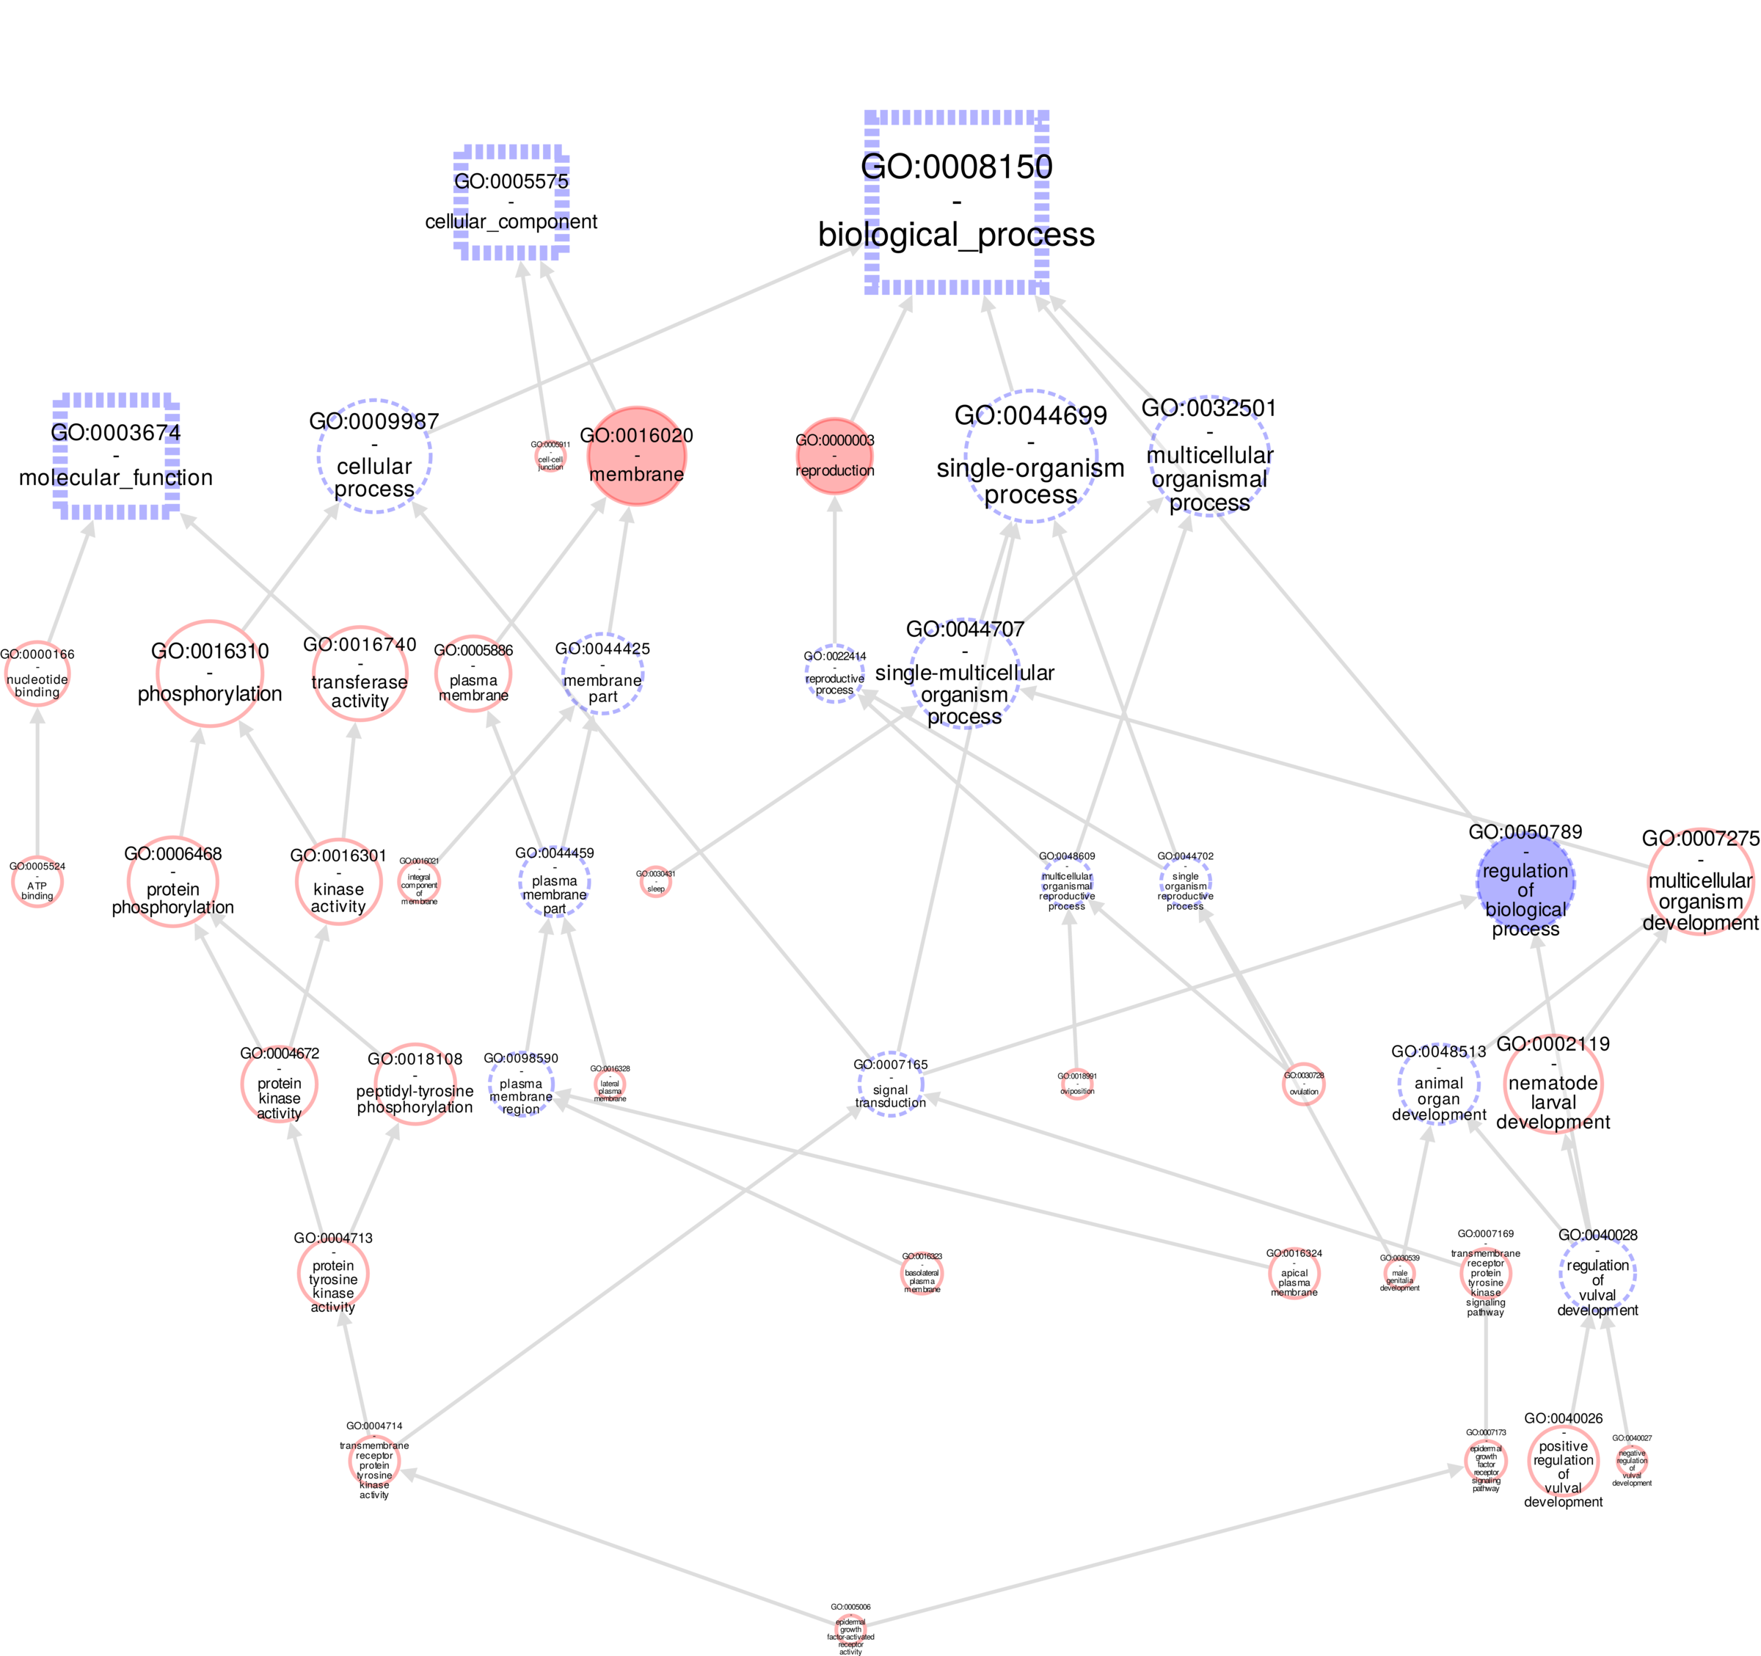
SObA Graph for GO Annotations
Notes:
We are also developing a SObA graph for Gene Ontology annotations.

Slide 14
Big Thanks To
Sibyl Gao and Todd Harris
Seth Carbon and Chris Mungall (AmiGO 2)
Notes:
Sibyl and Todd helped us implementing Cytoscape javascript on WormBase web site.
Our backend SOLR document store is modified from the one developed by Seth, Chris and others for the AmiGO2 project.

