Slide 1
Programmatic access to WormBase ParaSite

Slide 2
Access using R
Access our database directly from R, via the biomaRt package
Syntax almost identical to Ensembl
Very quick access to large amounts of multi-species data
Ideal for downloading a large dataset once, for further offline processing
Notes:
Syntax is the same as Ensembl, so there is plenty of guidance available online at sites like BioStars

Slide 3
WormBase ParaSite in R
Install the biomaRt package:
source("http://bioconductor.org/biocLite.R")
biocLite("biomaRt")
Include the biomaRt package:
library(biomaRt)

Slide 4
WormBase ParaSite in R
Establish a connection to WormBase ParaSite
mart <- useMart("parasite_mart”, dataset = "wbps_gene", host = "parasite.wormbase.org")

Slide 5
WormBase ParaSite in R
Example: get all the Schistosoma mansoni genes with a C. elegans orthologue:
genes <- getBM(mart = mart,
filters = c("species_id_1010", "with_celegans_homologue"), value = list("prjea36577", TRUE), attributes = c(”wbps_gene_id", "celegans_gene”))
head(genes)
wbps_gene_id celegans_gene
1 Smp_078570 WBGene00009448
2 Smp_063300 WBGene00004450
3 Smp_210640 WBGene00009305
4 Smp_049930 WBGene00010465
5 Smp_132740 WBGene00001395
6 Smp_132740 WBGene00001396

Slide 6
Language neutral queries
REST API allows access using any programming language
For processing large amounts of data: consider whether making one query to BioMart may be more suitable
Examples provided in Perl, Python, Ruby, Java, Curl and Wget

Slide 7
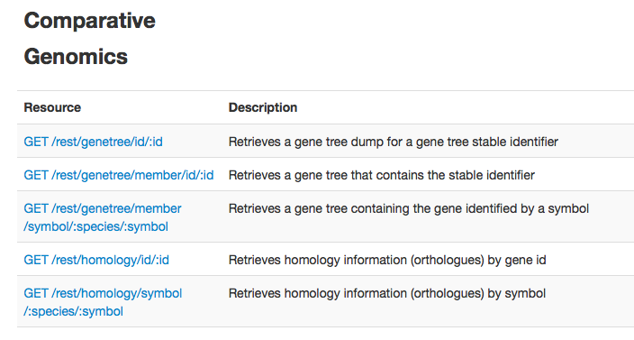
Endpoint Catalogue

Slide 8
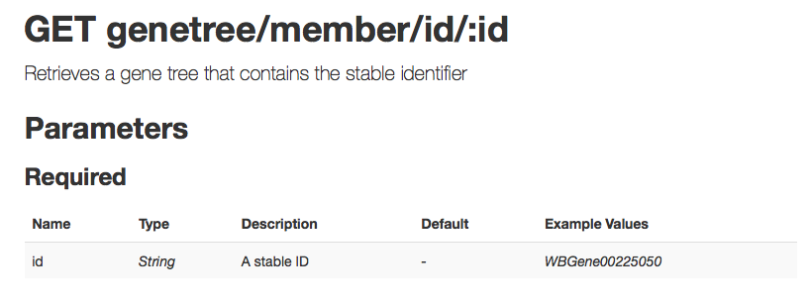
Endpoint Specifics

Slide 9
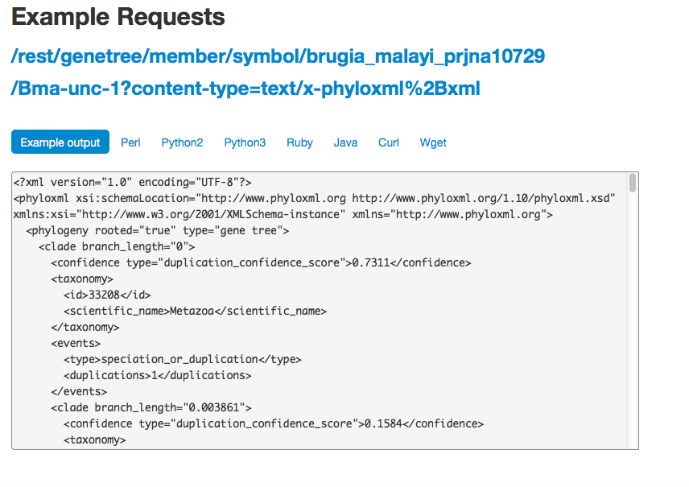
Endpoint Examples

Slide 10
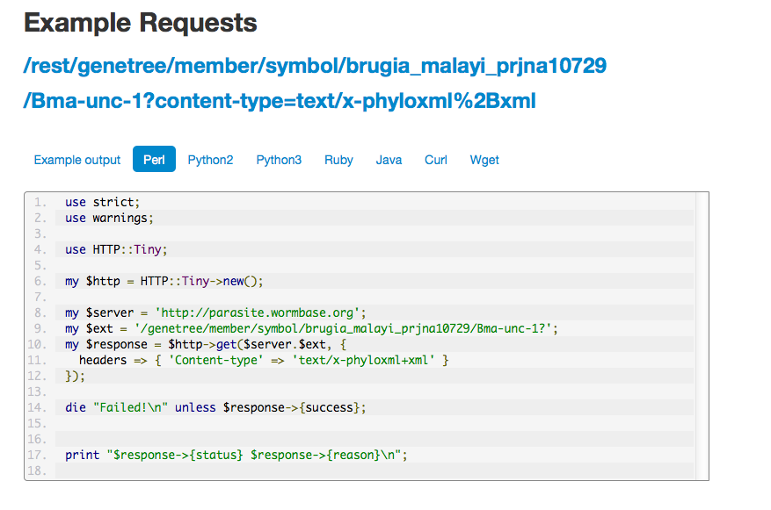
Code Examples

