Slide 1
Programmatic Access to WormBase Data
Sibyl Gao

Slide 2
WormBase Web APIs
Special URLs that are intended for programs
- Provide data in formats that are easy for programs to handle (JSON etc)
- Will refer to them as Web API or API
Why?
- Avoid repetitive manual tasks
- e.g. write a program to gather information, about a list of identifiers
- Develop custom visualization tools powered WormBase data
How?
- By making an HTTP request to a URL in your programming language
- Example libraries: requests (Python), HTTP::Tiny (Perl), Curl (command line)

Slide 3
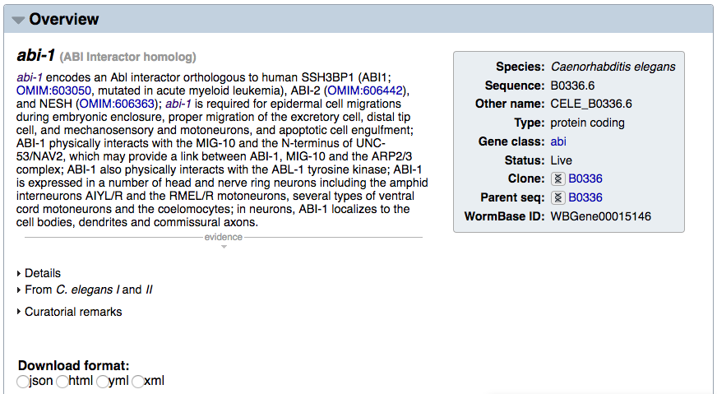
RESTful API
- Get the data that powers a widget or a field on WormBase
curl -X GET --header 'Accept: application/json' 'http://rest.wormbase.org/rest/widget/gene/WBGene00015146/overview'

Slide 4
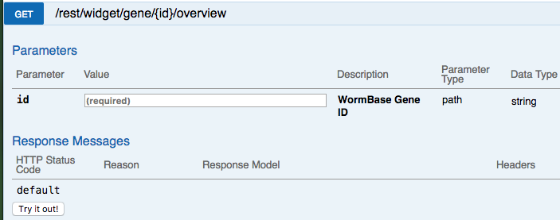
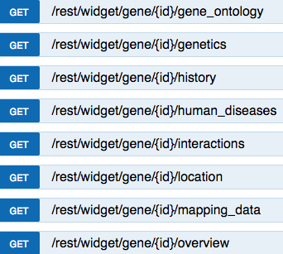
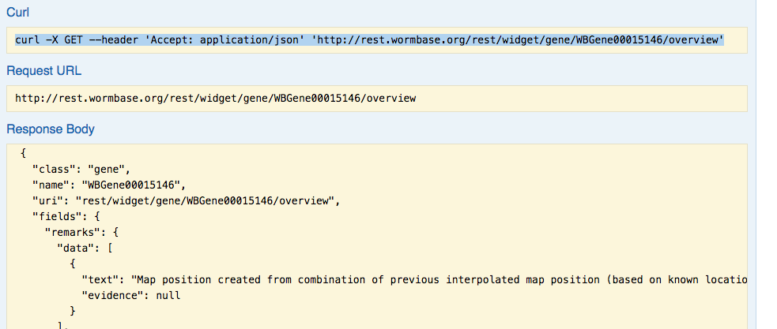
RESTful API
- documentations on which URLs you can access
Excerpt:

Slide 5
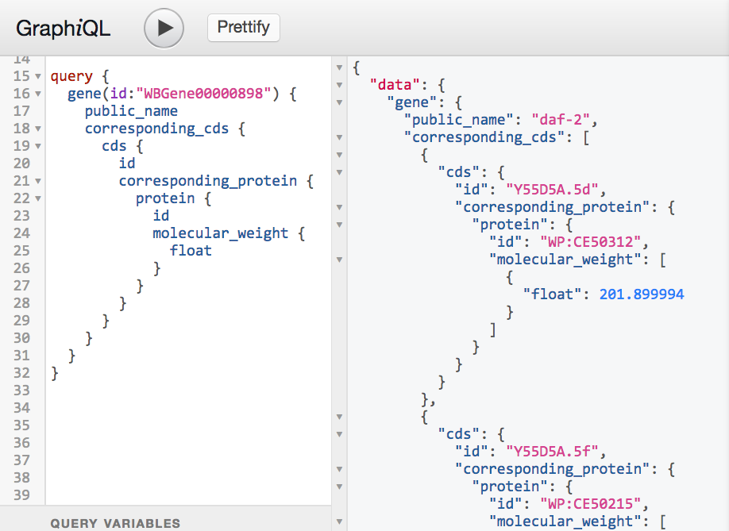
GraphQL API
(Experimental)
- provides access to any WormBase data (not just what we have a widget for)
curl -X GET --header 'Accept: application/json' 'http://graphql-dev.wormbase.org' --data-urlencode 'query={
gene(id: "WBGene00015146") {
public_name
}
}'

Slide 6
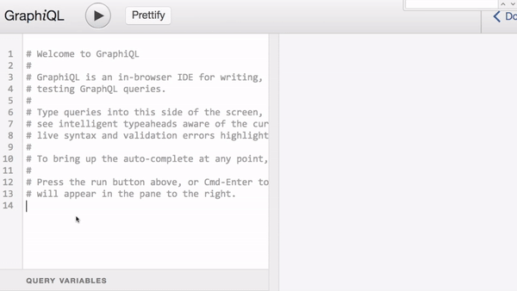
GraphQL API (Experimental)
Features an interactive development environment (IDE) to help with query construction:
- it “speaks” the GraphQL query language and understands WB data schema
- auto-completion
- query validation

Slide 7
Which one to use?
Short answer: RESTful API for now
Long answer:
- RESTful API:
- time-tested
- will continue to be supported
- default choice
- GraphQL API:
- experimental (bugs, instability, changes)
- suitable for exploring data through IDE
Please always sanity check the results your program produces 😃

Slide 8
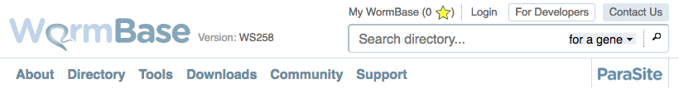
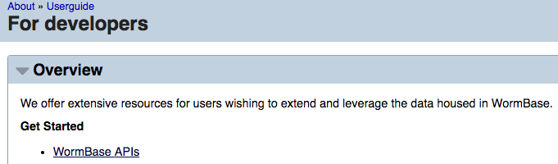
For More Info

Slide 9
Acknowledgement
Todd Harris
Adam Wright
Matt Russell
Juancarlos Chan

